Slide 1




OOP

Slide 2

HOMEWORK
OrcoStat – an analytic tool of negatively alive orcs and their equipment

Slide 3

No single correct solution
A lot
of good
solutions

Slide 4
HomeworK+
Solve puzzles
https://www.hackerrank.com/challenges/java-inheritance-1/problem​
https://www.hackerrank.com/challenges/java-inheritance-2/problem​
https://www.hackerrank.com/challenges/java-interface/problem​
https://www.hackerrank.com/challenges/java-method-overriding/problem​
https://www.hackerrank.com/challenges/java-instanceof-keyword/problem​

Slide 5

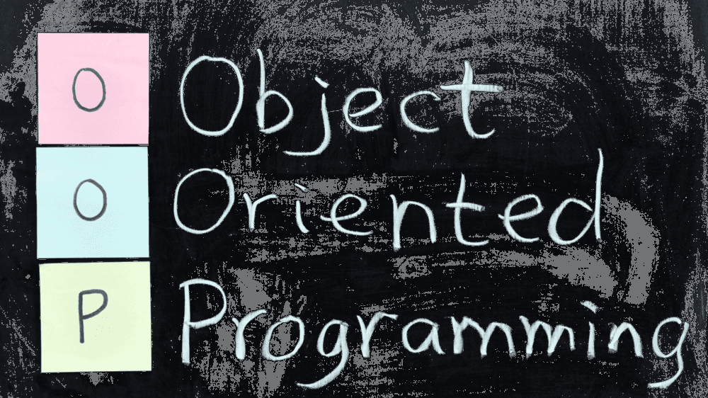

Notes:
Model of programming, where the program is organised as a process of interaction between objects

Slide 6
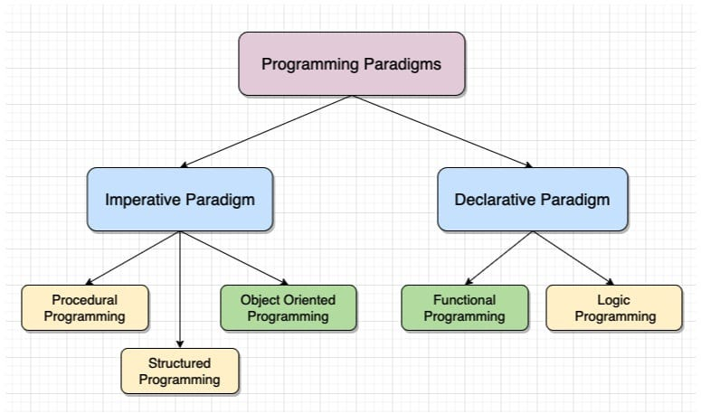
Paradigms

Slide 7
What is OOP​
Everything is an “Object”​
Object is a Class instance​
Object has a state and behavior​
Program – list of interacting objects​
55 OOP programming questions for developers

Slide 8
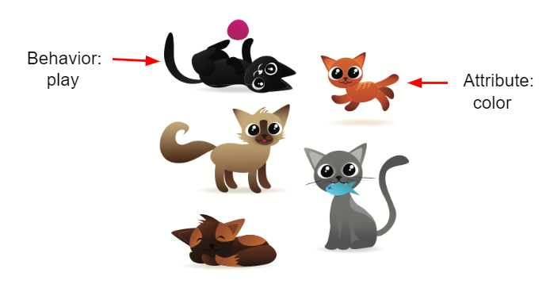
Class
constructor – how it is created
fields (attributes) – state, what does it know
methods – behaviour, what it can do

Slide 9
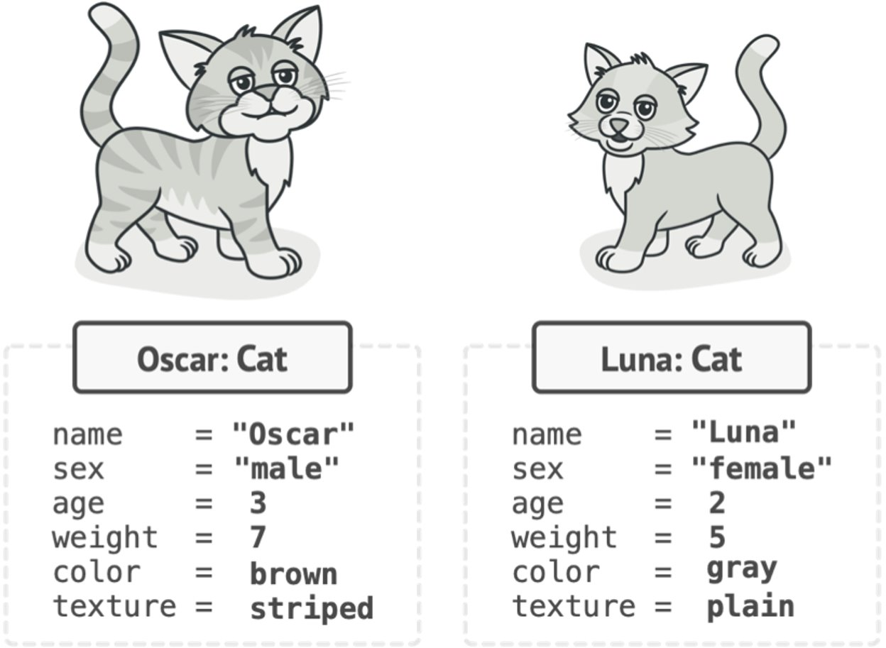
Object –instance of class

Slide 10
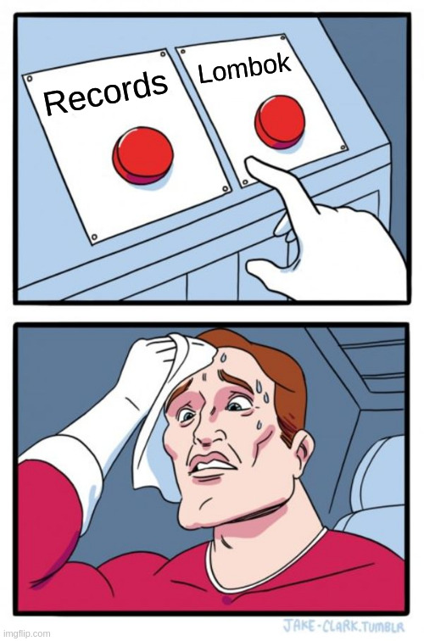
RECORDS
@Getter @Setter @ToString @AllArgsConstructor @EqualsAndHashCode public final class Cat { private final String name; private final int sex; private final int age; private final int weight; private final String color; private final String texture; }
public final class Cat { private final String name; private final int sex; private final int age; private final int weight; private final String color; private final String texture; public Cat( String name, int sex, int age, int weight, String color, String texture ) { this.name = name; this.sex = sex; this.age = age; this.weight = weight; this.color = color; this.texture = texture; } // getters / setters @Override public … equals/ hashCode/ toString…
} // 82 lines of code
vs
immutable
set of fields
no or minimal behavior
public record Cat( String name, int sex, int age, int weight, String color, String texture ) { }
vs
@Data public final class Cat { private final String name; private final int sex; private final int age; private final int weight; private final String color; private final String texture; }
vs

Slide 11
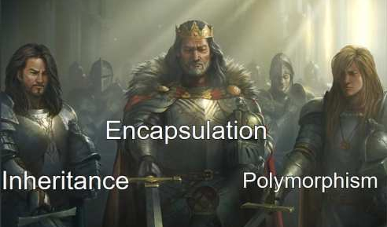
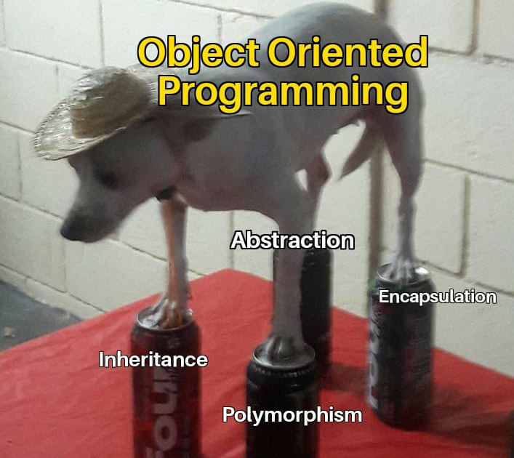
Key Pillars

Slide 12
Encapsulation
What: Putting your code in a secure box, keeping some parts of your code hidden and safe from outside interference.
Why: helps protect data and code from being accidentally messed up by other parts of your program
How: Access modifiers
public String name
protected String address
String homeDoorPin
private String tiktokPassword
Tip: use the least possible modifier

Slide 13
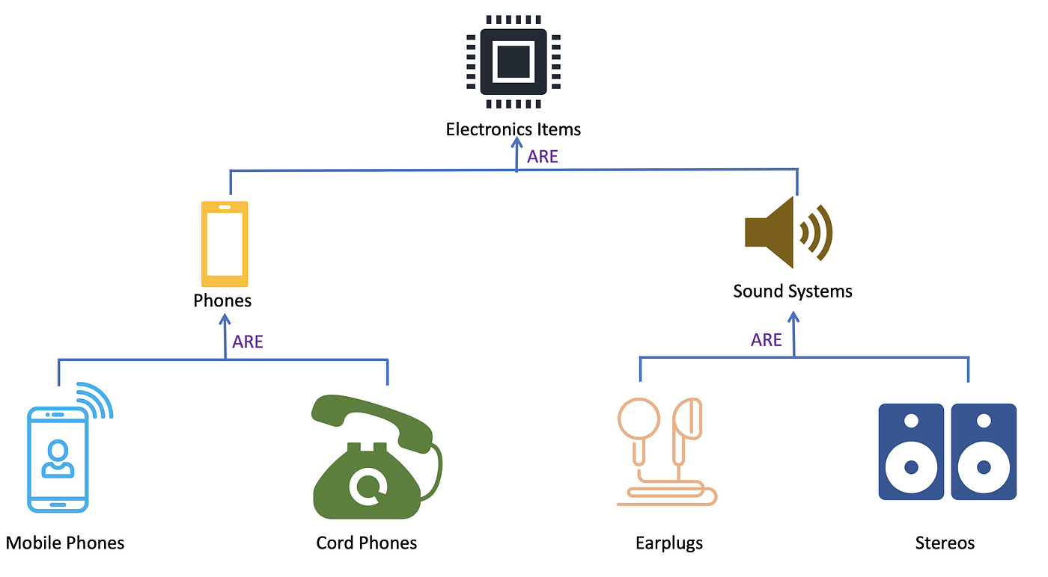
Inheritance
What: passing down traits in a family. It lets you create new code by borrowing and building upon existing code.
Why: saves time and makes code more organized. You can reuse the good parts and add new features to them without starting from scratch
How: class Scratch extends Scratch2
Tip: connect only logically-related classes like nerd from student, but do not inherit human from table just because all have “legs”

Slide 14
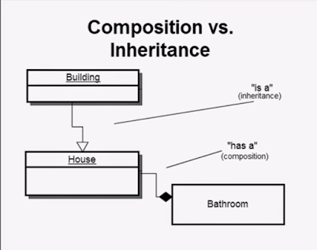
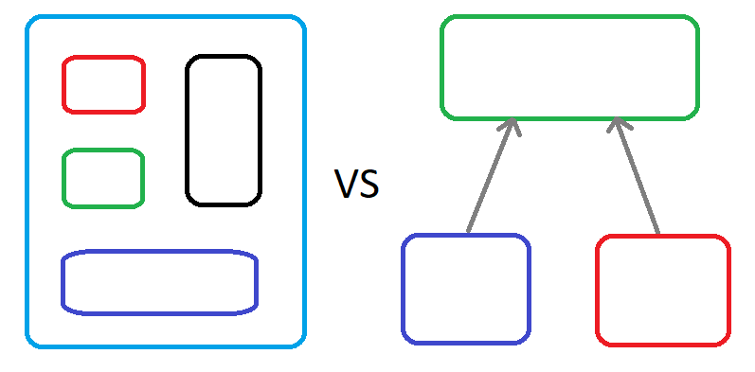
composition
over
Inheritance

Slide 15
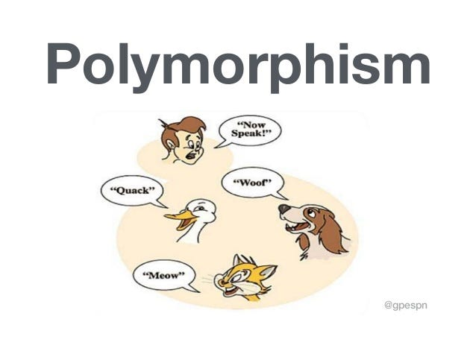
POlymorphism
What: shape-shifting superhero. It allows objects of different types to be treated as if they're all the same type
Why: makes your code flexible and versatile. You can write code that works with different objects without knowing their exact types, as long as they share certain behaviors.
How:
class Scratch extends Scratch2,
class Scratch implements Scratch3,
@Overrides method
…
Tip: avoid extends

Slide 16
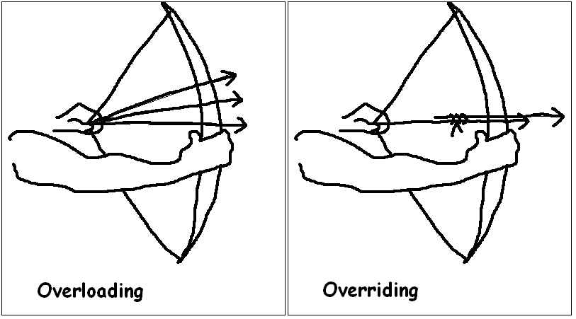
POlymorphism
Overloading – different signature
Overriding – the same signature

Slide 17
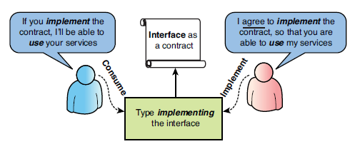
Interface
public interface Collection { void add(Object element); Object[] getElements(); int size(); }

Slide 18
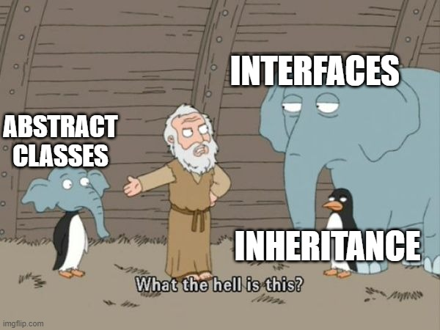
Abstract class
public abstract class Technique { private final Collection equipage; private int price; protected Technique(Collection equipage) { this.equipage = equipage; } abstract String shoot();
…
}

Slide 19
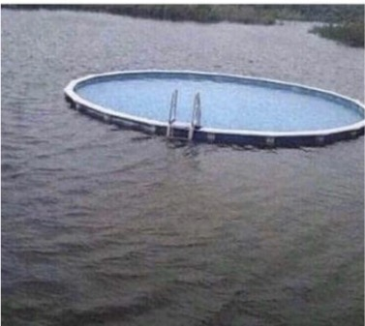

inner anonymous inherited class
inner class
static class
anonymous class
abstract class

Slide 20
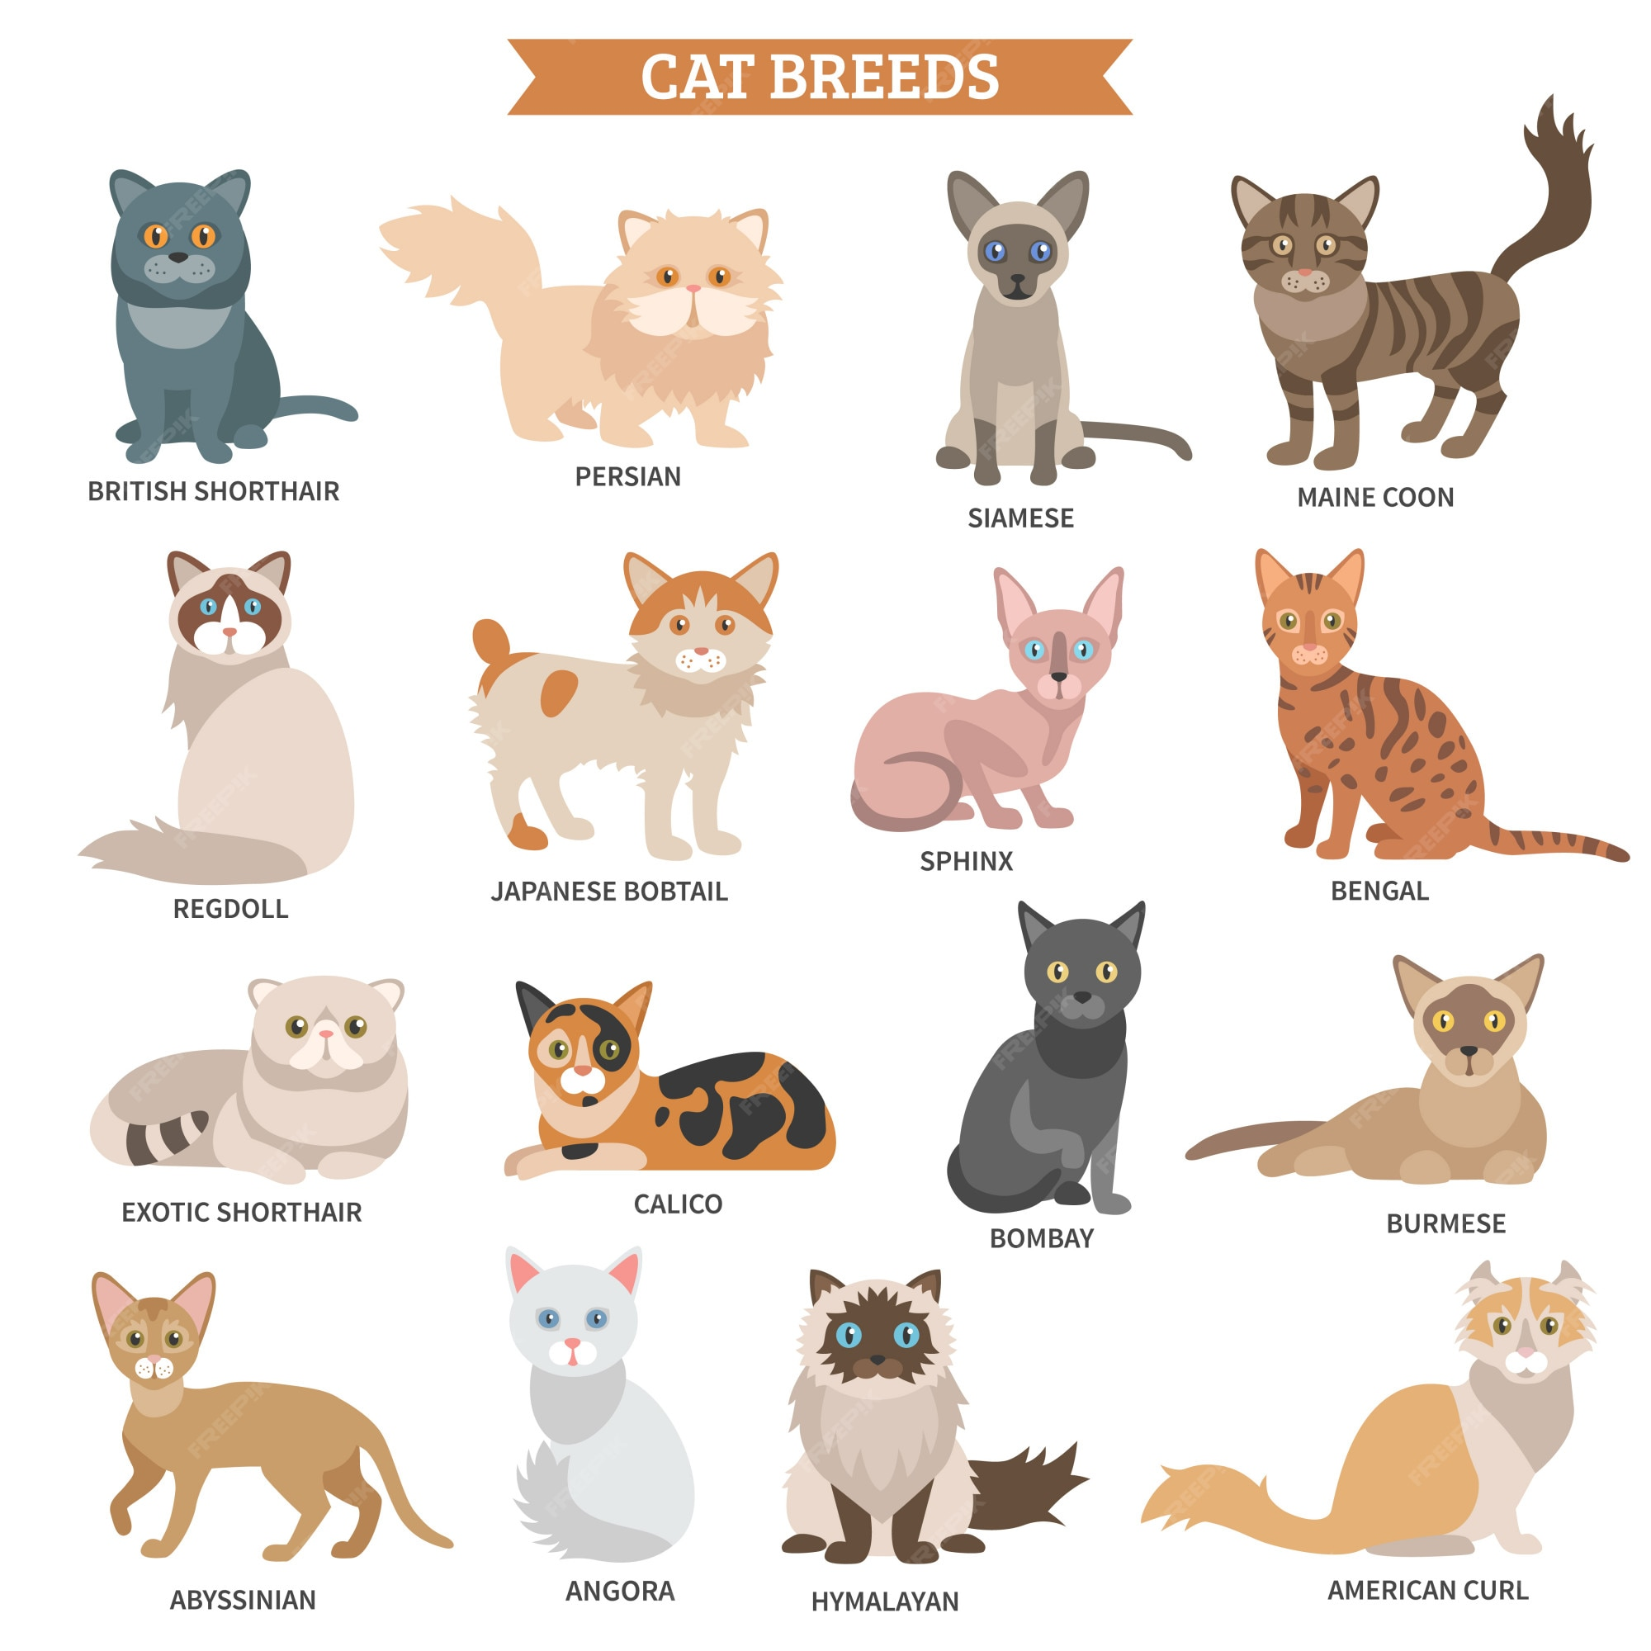
ENUM
public enum Breed { ABYSSINIAN, BENGAL, BIRMAN, BRITISH_SHORTHAIR, MAINE_COON, PERSIAN, REGDOLL // ... }

Slide 21
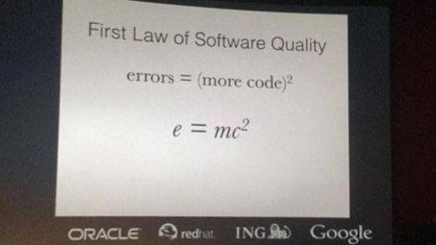
KISS – Keep it simple

Slide 22

we learned
Everything is Object
Encapsulate. Hide state. Expose behavior
Write a dynamic system. Implement interfaces
Prefer composition. Avoid extension
Visualise your solution
You are cool! Keep going 💪

Slide 23

Literature
Object-Oriented-Programming Concepts in Java​
55 OOP programming questions for developers
Java Classes and Objects
Test-Driven Development: By Example​ (Part 1)
Bowling Game Kata (and detailed solution)

